Slide 1
AS91883(1.7) & AS91884(1.8) Documentation
Jack Percy

Slide 2
Maori Number Quiz.
Link to GitHub Repository: https://github.com/Jaxku/Maori-Number-Quiz-Assessment-
Links to Trello board / project management tools:
https://trello.com/b/bw5X0whk/maori-test-numbers-1-10
Link to final version of your program: [here]

Slide 3
Describe relevant Implications: 1
Relevant implication | Describe the implication and give an example
Functionality | Functionality is about making sure the program works as expected. It should work for all different scenarios such as the expected use, boundary use and unexpected usage. For example, when a user is entering an answer they shouldn’t need to worry if the first letter is capitalised or not so if the user inputs “tahi” instead of “Tahi” the program won’t fail them and not give them the point for the answer. And for the unexpected usage, the program shouldn’t crash if the user enters a value that is invalid like ‘One’ and should simply fail the user for that question and move on to the next question.
Usability | Usability is about how easily the user can get the program to achieve what it was designed to achieve. It deals with issues like making instructions and error messages clear and easy for users to understand. It is vital to eliminate any frustration to have customer satisfaction.
Aesthetics | Aesthetics is about the program's overall appearance. A program which looks good because it includes spaced out instructions, prompts this is going to be more aesthetically pleasing than one which is composed of unspaced plain text.
Notes:
Additional rows can be added by clicking in the last cell and then using the Tab key

Slide 4
Describe relevant Implications: 2
Relevant implication | Describe the implication and give an example
Social | The social implications of a computer program are about the affect it might have on users, the wider community, and society as a whole. For example, a quiz like this that is to help teach and test the user on basic Maori numbers shouldn’t throw them into the deep end with numbers that they most likely won’t be able to answer as this will have a negative impact on the user and they most likely won’t use the program again.
Future proofing | Future proofing is about making a program which is flexible and adaptable and easy to modify later if necessary. The code needs to be well set out and commented so that another programmer can make changes easily at some future time. Someone who wants to modify my code in the future needs to understand the purpose and reasoning behind different parts of the code. Also, its important to use constants rather than literals – to minimise the number of places where changes have to be made.
Notes:
Additional rows can be added by clicking in the last cell and then using the Tab key

Slide 5
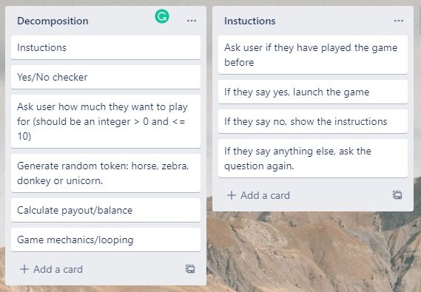
Component 1 (Instructions and Yes/No checker)

Slide 6
Yes/No - Test Plan
Additional rows can be added by clicking in the last cell and then using the Tab key
Test Cases - input | Expected output
yes | Program continues
Y | Program continues
No | Program continues
N | Program continues
Yes | Program continues
Maybe | Please enter either “Yes” or “No”
Notes:
Additional rows can be added by clicking in the last cell and then using the Tab key

Slide 7
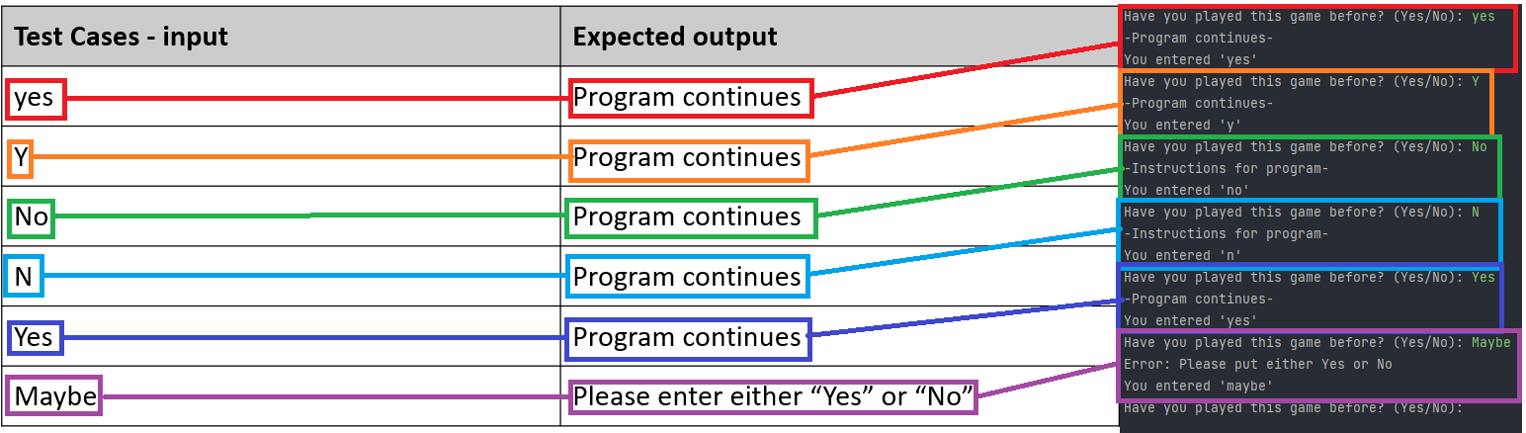
Yes/No checker - Testing
All test statements worked as expected
Notes:
You must show the results of testing. For each component, include a screenshot proving it works. You can also include notes about each test.

Slide 8
Instructions - Test Plan
Test Cases - input | Expected output
Have you played before? Maybe | <error> Please choose y/n
Have you played before? Yes | Game starts
Have you played before? No | Show instructions, then start the game
Notes:
Additional rows can be added by clicking in the last cell and then using the Tab key

Slide 9
Yes/No checker: Trialling
Trial 1 01_yes_no_v1.py | Program works but requires user to enter response using lower case. User also required to type "yes" or "no" and it won't accept "y" or "n"
Trial 2 01_yes_no_v2.py | Fixes the case problem and adds options for "y" and "n" Prints result of valid input, prevents invalid input but quite cumbersome for testing
Trial 3 01_yes_no_functions_v1.py | I made the code, from Trial 3, into a function which makes it easy to recycle for other yes/no questions I might incorporate into my program. I wll therefore use this function in my final program
Notes:
NOTE: Trialling needs to happen for at least 2 of your components but is not necessary for ALL components.
Trialling is not the same as testing. Trialling is about finding different ways of building the same component. Show evidence of your trialling here. Select one of your trials for further development and give reasons for your choice.

Slide 10
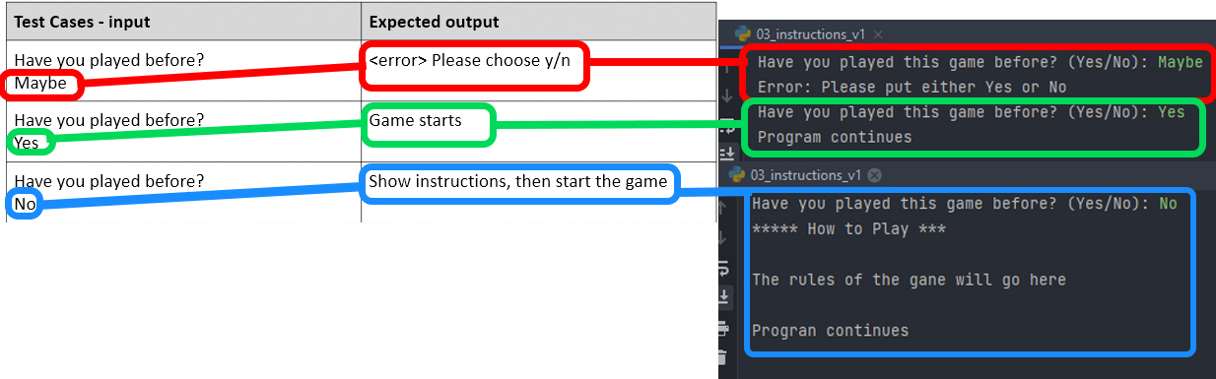
Instructions with (with yes/no checker) testing
All testing worked as expected
Notes:
Show testing for your assembled outcome below. This should include a test plan followed by screenshot proof.

Slide 11
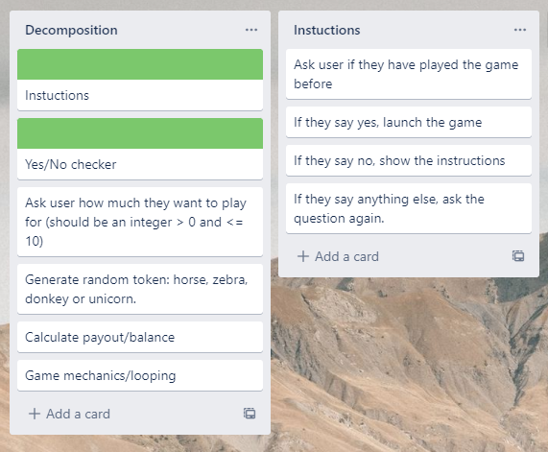
Component 2 (How Much)

Slide 12
How Much - Test Plan
Test Cases - input | Expected output
xxii (invalid – string) | <error> Please enter a whole number between 1 and 10
0.5 (invalid – float) | <error> Please enter a whole number between 1 and 10
O (invalid – too low) | <error> Please enter a whole number between 1 and 10
11 (invalid – too high) | <error> Please enter a whole number between 1 and 10
1 (valid – lower boundary) | Program continues
10 (valid – upper boundary) | Program continues
Notes:
Additional rows can be added by clicking in the last cell and then using the Tab key

Slide 13
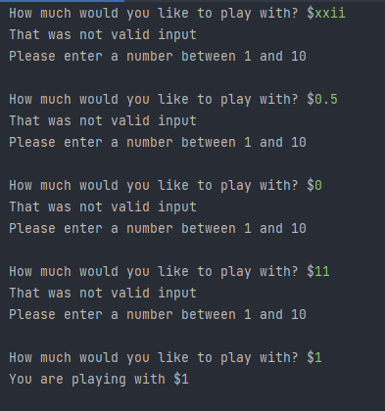
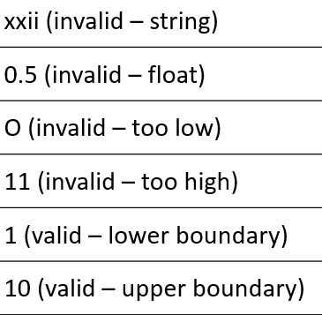

How much (testing)
Inputs being tested
All testing worked as expected
Notes:
Show testing for your assembled outcome below. This should include a test plan followed by screenshot proof.

Slide 14
How much Trialling: Trialling
Trial 1 04_how_much_v1 | Program works but only if the user enters integers. It correctly refuses integers outside the required range but crashes when invalid (string/float) data is entered
Trial 2 04_how_much_v2 | Program responds appropriately to invalid by refusing it without crashing and offering the user an opportunity to try again. However, the code is quite long and could be made more efficient. I ran into some trouble with this version expect ValueError: and couldn’t find a solution in a timely manner therefore I can’t and won’t be using this in my program.
Trial 3 04_how_much_v3 | In this 3rd trial I included the valid range (1-10) as the basis of the while loop which eliminated the need to use the 'valid' variable. The result is more efficient yet every bit as adaptable for recycling as Trial 2.
Trial 4 04_how_much_v4 | Changed v3 into a function. Made user_balance a more generic variable name 'response' and changed the condition and position of the number comparison into the loop to make the function recyclable. I will adopt this one in my final program
Notes:
NOTE: Trialling needs to happen for at least 2 of your components but is not necessary for ALL components.
Trialling is not the same as testing. Trialling is about finding different ways of building the same component. Show evidence of your trialling here. Select one of your trials for further development and give reasons for your choice.

Slide 15
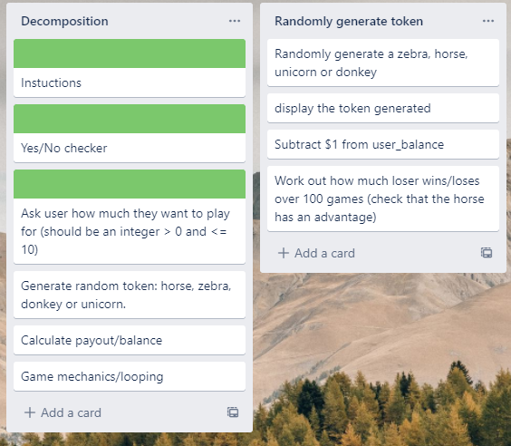
Component 3 (Generate random token)
The pay-out schedule is:
Donkey: lose $1.00
Horse/Zebra: lose $0.50
Unicorn: win $4.00
(i.e. if user starts with $1 and
gets a Unicorn, their balance
will be $5.00)
In this component, we need to
check that over time the user
loses money - to make the game
viable.

Slide 16
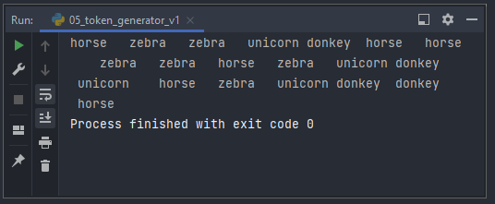
Test Plan: tokens randomly generated
Test Cases - input | Expected output
Run the program | The program should output 20 tokens with at least one each of: horse, donkey, zebra and unicorn. The order of the tokens must be random.
The Program generates random choices, in a random order
Notes:
Additional rows can be added by clicking in the last cell and then using the Tab key

Slide 17
Test Plan: house has the advantage
Test Cases - input | Expected output
User starts with $100 Run program | User should lose money (final balance should be less than $100)
Notes:
Additional rows can be added by clicking in the last cell and then using the Tab key

Slide 18
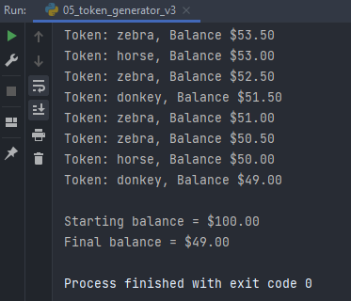
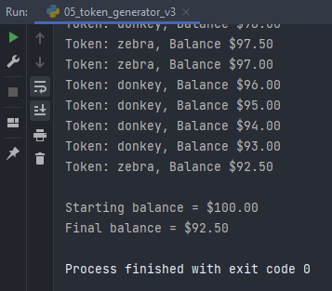

Generate random token - Testing
Testing on right (Trial 2) shows
results for 100 rounds:
10% chance of a unicorn
30% chance for each of
donkey, zebra and horse
Testing on right (Trial 3) shows
results for just 10 rounds:
5% chance of a unicorn
30% chance for each donkey, zebra and horse. The house advantage becomes clearer if we run the program for man than 100 rounds:
Notes:
Show testing for your assembled outcome below. This should include a test plan followed by screenshot proof.

Slide 19
Generate random tokens: Trailling
Trial 1 05_ token_generator_v2 | This programs chooses from a list of ‘horse’, ‘unicorn’, ‘donkey’ and ‘zebra’. When run 100, times it became clear the house would make very little money and the player won’t notice the advantage to the house as easily.
Trial 2 05_token_generator_v3 | In this trial, I changed the list so that there were 10% unicorns and 30% of each of the others (1 unicorn and 3 each of the others). This did give the house an advantage.
Trial 3 05_token_generator_v4 | In my third trial, instead of choosing items from a list, I chose a random integer between 1 and 100. The schedule was set up so that users had a 5% chance of getting a unicorn, a 30% chance of getting a donkey and a 65% chance of getting a horse or zebra. For this last 65%, it awarded horse or zebra depending on whether or not the number generated was even (horse) or odd (zebra)
Notes:
Additional rows can be added by clicking in the last cell and then using the Tab key

Slide 20
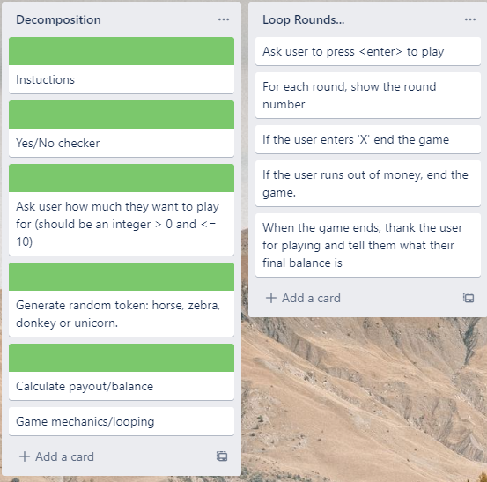
Game mechanics and looping
Notes:
Show testing for your assembled outcome below. This should include a test plan followed by screenshot proof.

Slide 21
Game mechanics and looping – Test Plan
For testing purposes, each round the user will lose $1 (I.e.: they get a donkey each time)
Test Cases - input | Expected output
User starts with $5 User continues playing until the money runs out | Game should go for 5 rounds. Each round should be correctly numbered After 5 rounds, It should display ‘Sorry you have run out of money’
Starting amount $5 User plays 3 rounds and then exits | Game should go for 3 rounds When user enters ‘X’ the game should end Final balance should be $2
Notes:
Additional rows can be added by clicking in the last cell and then using the Tab key

Slide 22
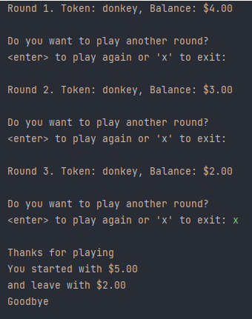
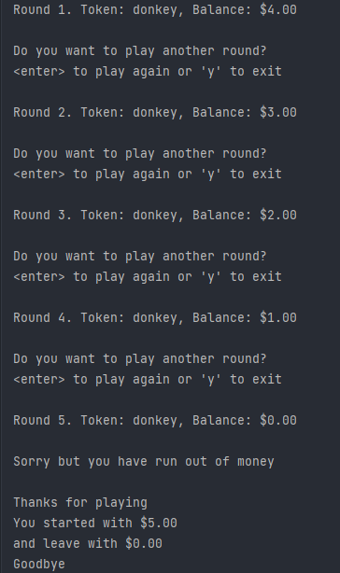
Generate random token - Testing
The user can exit at the start of any round.
It will print a farewell message with the amount of money the user started with and the amount the user lost.
Ran out of money and ends the game as expected
A farewell message with the amount of money the user started with and the amount the user lost.
Notes:
Show testing for your assembled outcome below. This should include a test plan followed by screenshot proof.

Slide 23
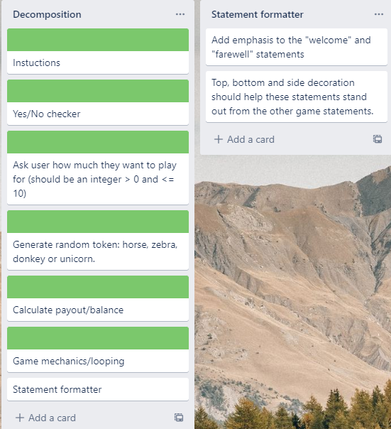
Generate random token - Testing
I realised that we often need to make output stand out and creating a function to help to do this is a good idea.
This component was added to the decomposition near the end of the development process.
Notes:
Show testing for your assembled outcome below. This should include a test plan followed by screenshot proof.

Slide 24
Test Plan: Statement formatter
Test Cases - input | Expected output
Statement 1: “Welcome to the Lucky Unicorn Game” Decoration: “*” | -------------------------------------------------------- --- Welcome to the Lucky Unicorn Game --- --------------------------------------------------------
Statement 2: “Congratulations, you got a Unicorn” | !!!!!!!!!!!!!!!!!!!!!!!!!!!!!!!!!!!!!!!!!!!!!!!!!! !!! Congratulations, you got a unicorn !!! !!!!!!!!!!!!!!!!!!!!!!!!!!!!!!!!!!!!!!!!!!!!!!!!!!
Statement 3: “Goodbye” | ************** *** Goodbye *** **************
Notes:
Additional rows can be added by clicking in the last cell and then using the Tab key

Slide 25
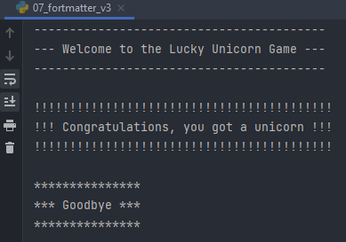
Statement formatter - Testing
Statement formatter function worked as expected and produced the expected results.
Notes:
Show testing for your assembled outcome below. This should include a test plan followed by screenshot proof.

Slide 26
Test Plan: Assembled outcome
Test Cases - input | Expected output
Run program Played before = Maybe Played before = No | Welcome message displays Error – please answer yes or no Instructions display
Enter amount to play with: xlii 0.5 0 11 1 | Error Error Error Error You are playing with $1. Press <enter> to start
Notes:
Additional rows can be added by clicking in the last cell and then using the Tab key

Slide 27
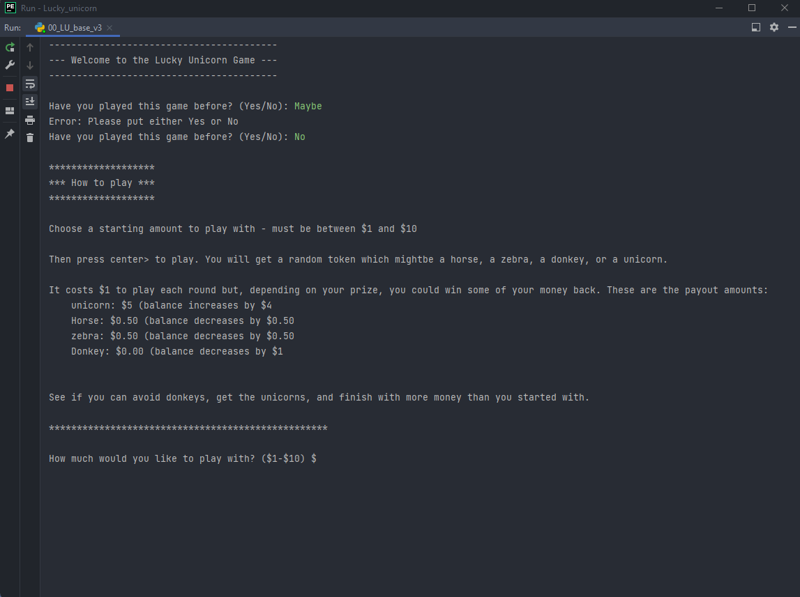
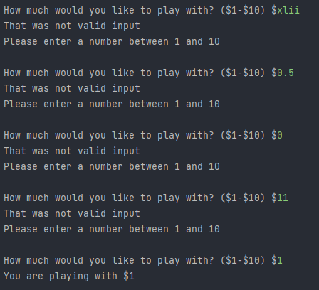
Assembled outcome – testing 1
Worked as expected – results produced match those in the plan on the preceding page
Notes:
Show testing for your assembled outcome below. This should include a test plan followed by screenshot proof.

Slide 28
Test Plan: Assembled outcome 2
Test Cases - input | Expected output
Plays with $1 until money runs out | For each round: Random token generated Balance and round number updated At end: Stats generated showing starting amount of $1 and final balance of $0.50 or $0.00
Run program Played before = yes Amount to play with = 10 | Welcome message displays No Instructions displayed
Notes:
Additional rows can be added by clicking in the last cell and then using the Tab key

Slide 29
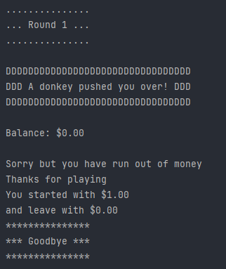

Assembled outcome – testing 2
Worked as expected – results produced match those in the plan on the preceding page
Notes:
Show testing for your assembled outcome below. This should include a test plan followed by screenshot proof.

Slide 30
Test Plan: Assembled outcome 3
Test Cases - input | Expected output
Play until balance is $3.00/$2.50, then 'X' to quit | For each round: Random token generated Balance and round number updated (lose $1 for donkeys, lose $0.50 for a horse or a zebra, and gain $4 for any Unicorn At end: Stats generated showing starting amount of $10 and final balance of $2.50 or $3.00
Notes:
Additional rows can be added by clicking in the last cell and then using the Tab key

Slide 31
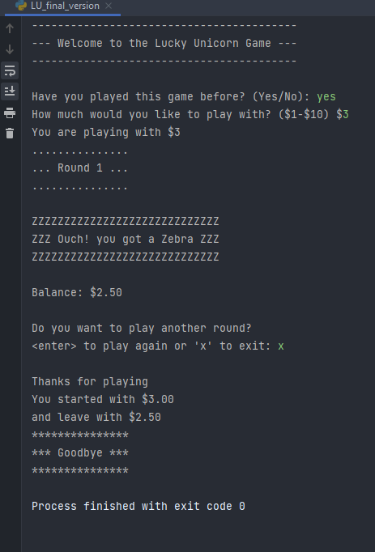
Assembled outcome – testing 3
Worked as expected – results produced match those in the plan on the preceding page
Notes:
Show testing for your assembled outcome below. This should include a test plan followed by screenshot proof.

Slide 32
Address relevant Implications:
Relevant implication | Explain how your final outcome addresses each implication
Social | To limit people from throwing their life savings away a limit of $10 can be spend per game on the Lucky Unicorn game
Aesthetics | The aesthetics of the program when run makes it look easier to read with characters surrounding important info like the outcome of each round allows the player to see what’s going on more easy. For the Aesthetics of the code using comments makes it easier for people to find out what’s going on in the code.
Functionality | After testing the code to see if it is playable I found it functions as expected. All error messages for the user works fine so they know what mistake they made and the code doesn’t crash when the program is doing what it requires to do.
Usability | At the start of my program new users are able to get clear instructions on how to play and experienced users can just jump right into the fun.

Slide 33
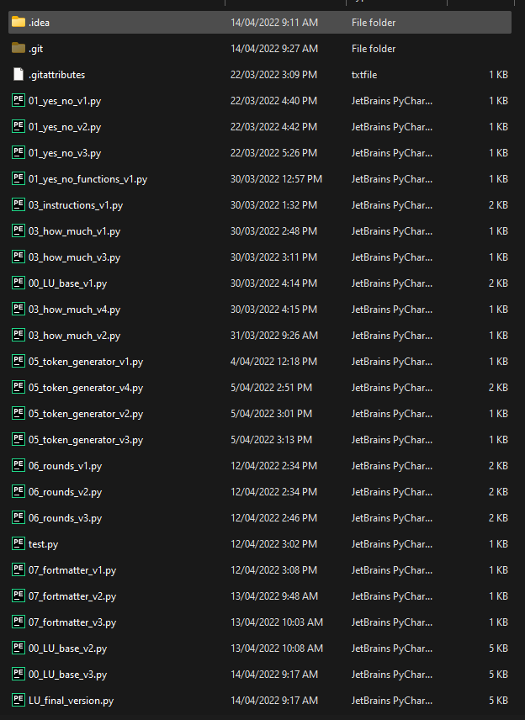
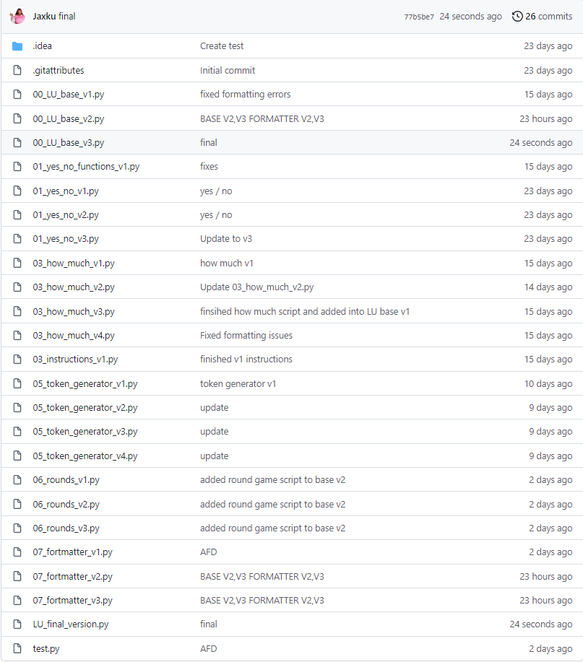
Version Control Evidence:
<- (left) Local (OneDrive) directory
Project saved in GitHub repository
(right) ->
Notes:
Your version control evidence should go here. This could be in the form of screenshots (both of your GitHub repository as well as your local project folder) as evidence of your incremental development.

Slide 34
Final Discussion:
While developing this program I tested it with a test plan after each function was written. This allowed me to move on to the next function with the piece of mind that my code functions as expected and I won’t have a problem with my final script.
The test plan allowed me to test chunks of the code I produced and make sure they work which allows me to not cause major mistakes
I tested my code to check for PEP8 standards for other coders to look at the code and be able to understand my code easier it also helps with the aesethics.
Notes:
Discuss how the information from planning, testing and trialling of components assisted in the development of a high-quality outcome.

